Slide 1
Demo Path Summary
Digital Marketing
Sales
Customer 360
Service
Contact Center
Service
Digital campaign
Lead generated
Sales person – road to the sale
Sales manager – reporting (Power BI)
Insights & AI
Platform
PowerApps & Flow

Slide 2
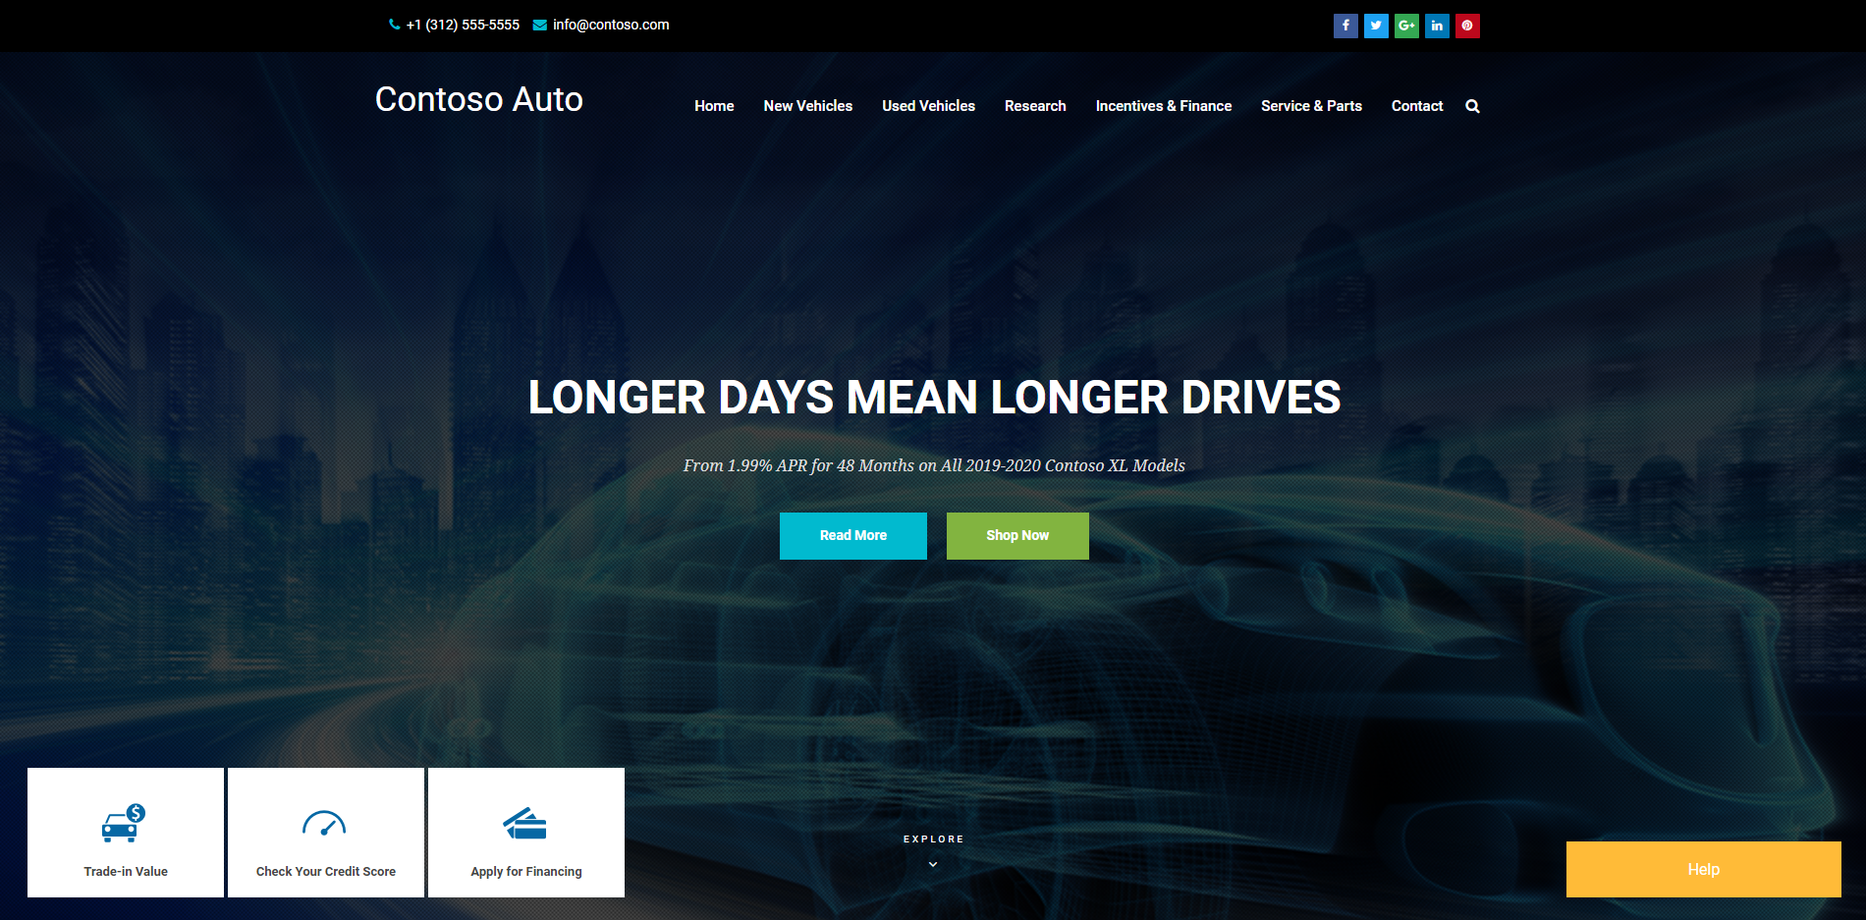

Slide 3
Sales path summary
Sales person
Sales manager
Dashboard
Road to the sale
Dashboard
Reporting
Lead handling

Slide 4
Sales person
The Sales Person logs into Dynamics at the start of the day. They review the dashboards and leads for the day.
They review their leads and begin to work the lead through the sales process
If they have existing contacts, they can review the Relationship Analytics and other insights the system may provide
Once a vehicle is selected, the Sales Representative can create multiple deals within the opportunity
Once the deals are presented to the customer and one is selected, then the sale moves to the finance department for completion of contracts, and then to delivery

Slide 5
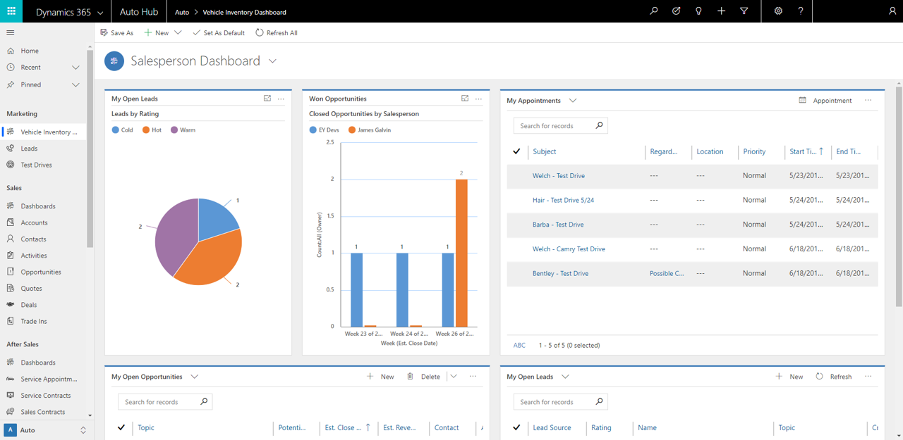

Slide 6
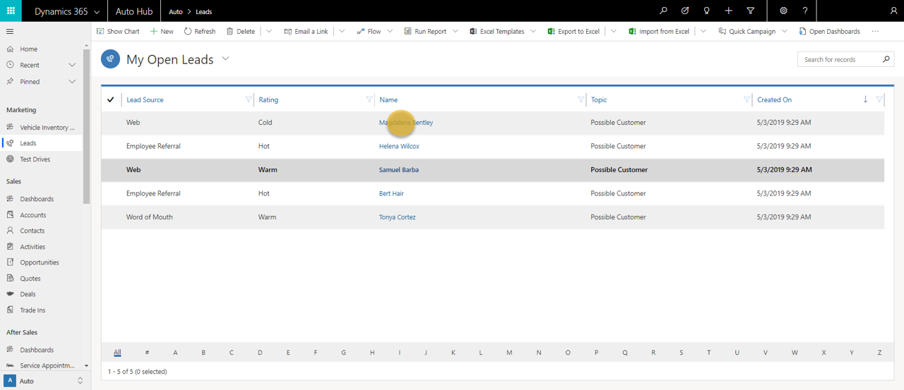

Slide 7
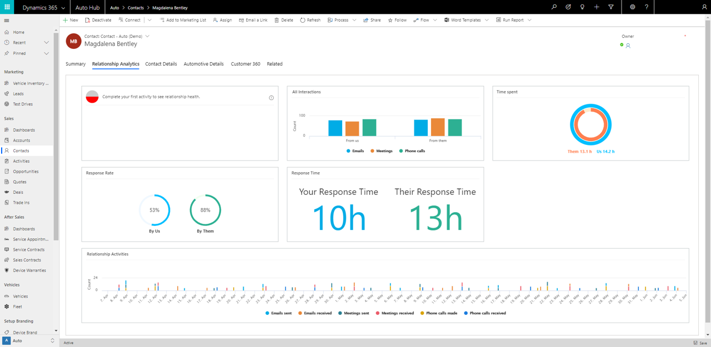

Slide 8
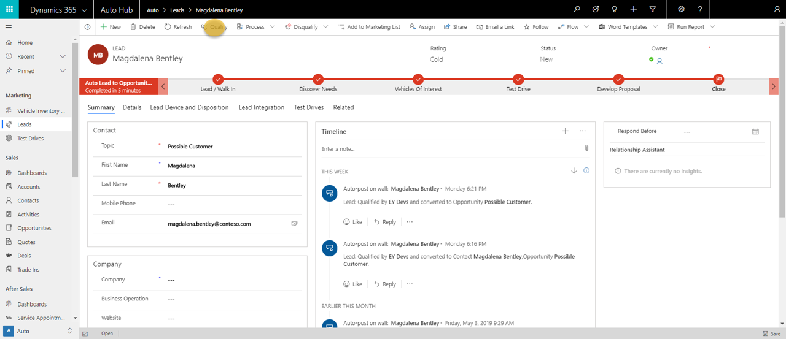
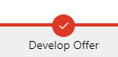

Slide 9
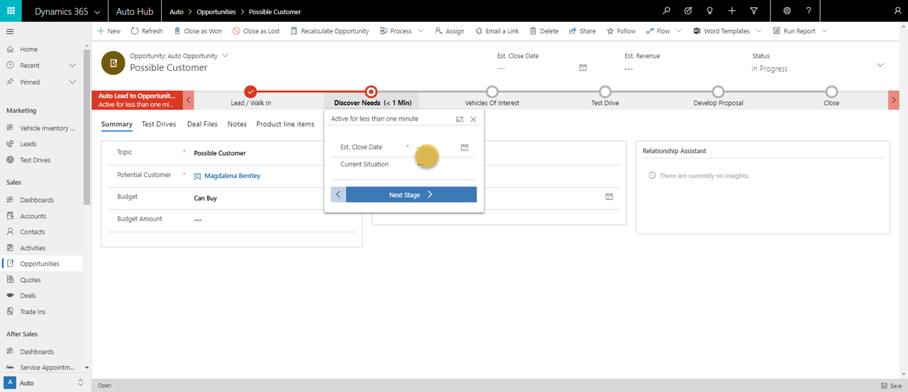
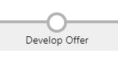

Slide 10


Slide 11
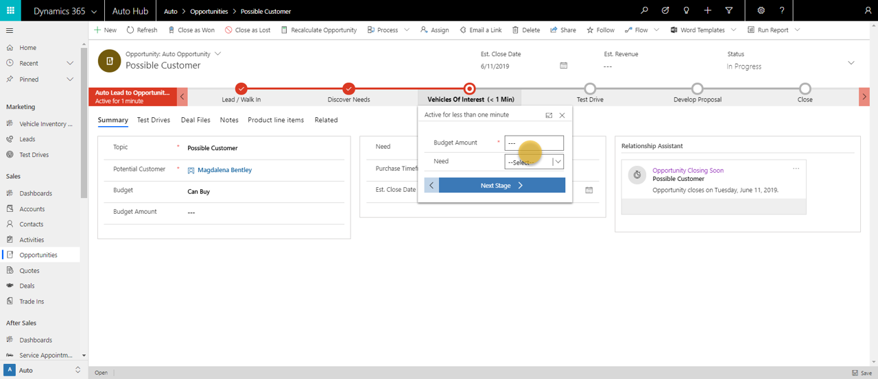

Slide 12
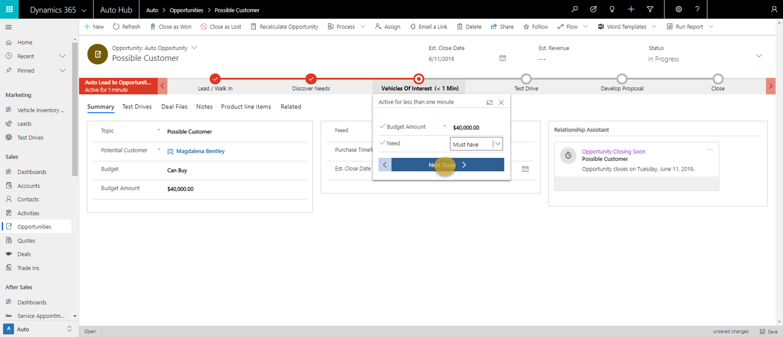

Slide 13
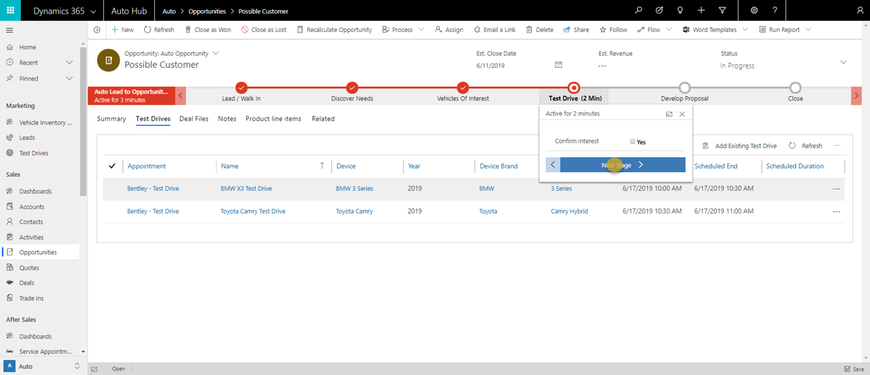

Slide 14
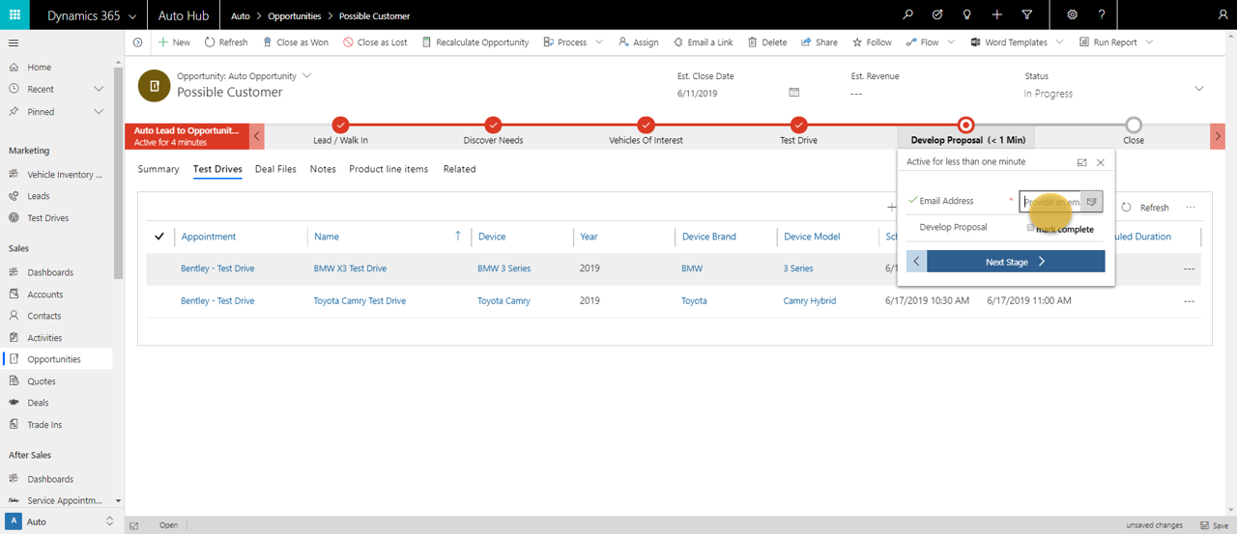
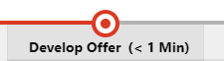

Slide 15
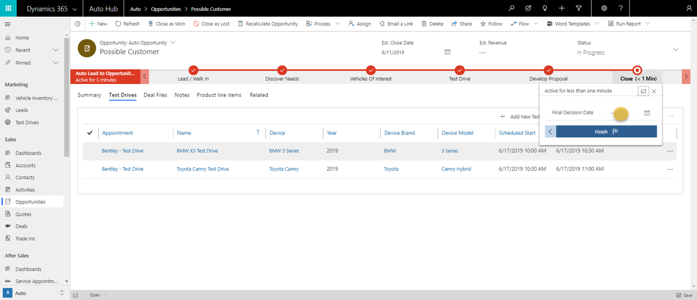

Slide 16
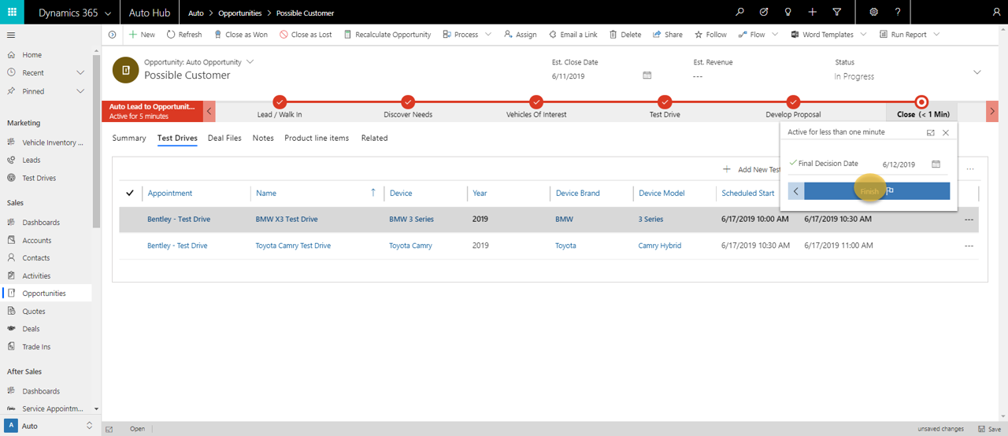

Slide 17
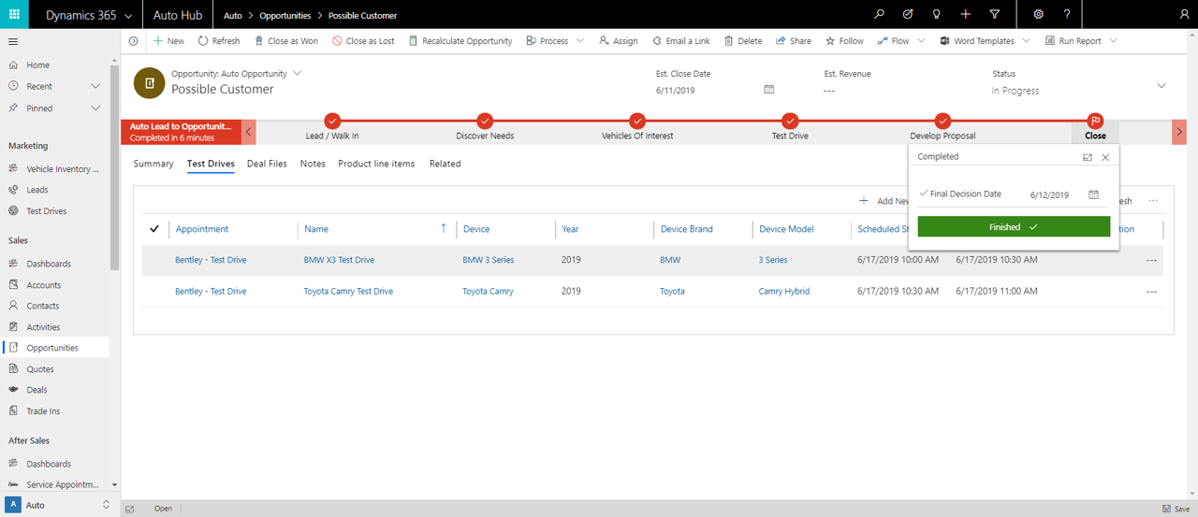

Slide 18
Sales Manager
Sales Manager Dashboard to review overall sales, manage leads, view appointments
Showroom Analysis Dashboard allows the sales manager to review overall status and performance of the showroom

Slide 19
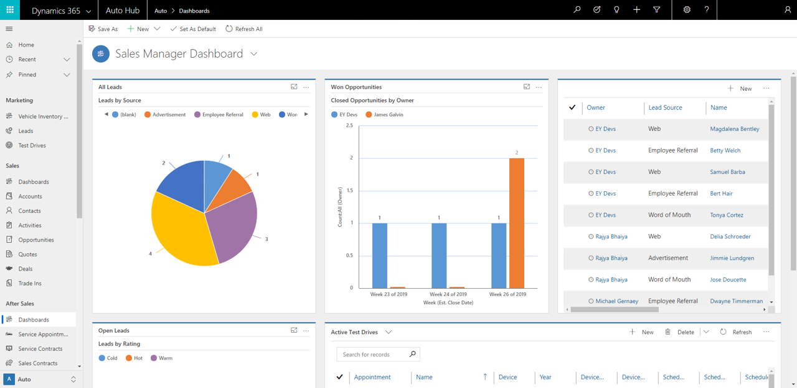

Slide 20
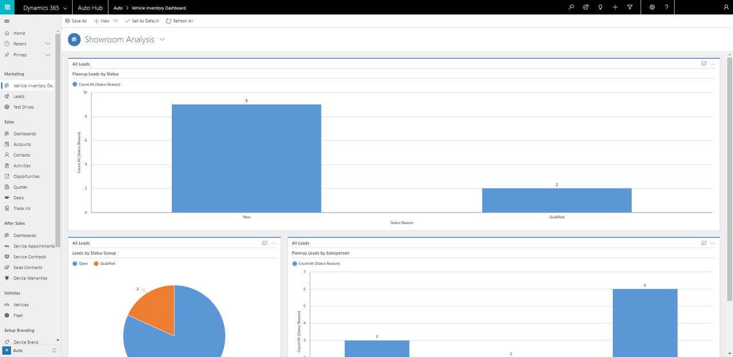

Slide 21
Service path summary
Contact center – proactive service identification
Contact Center – service scheduling
driver – finalizes service appointment
Dealer service advisor – oversees service delivery
Close & Cashiering
Survey
Promo
Reporting

Slide 22
Contact Center – service scheduling
The contact center manager logs into the Microsoft Connected Vehicle Platform to review the dashboards

Slide 23
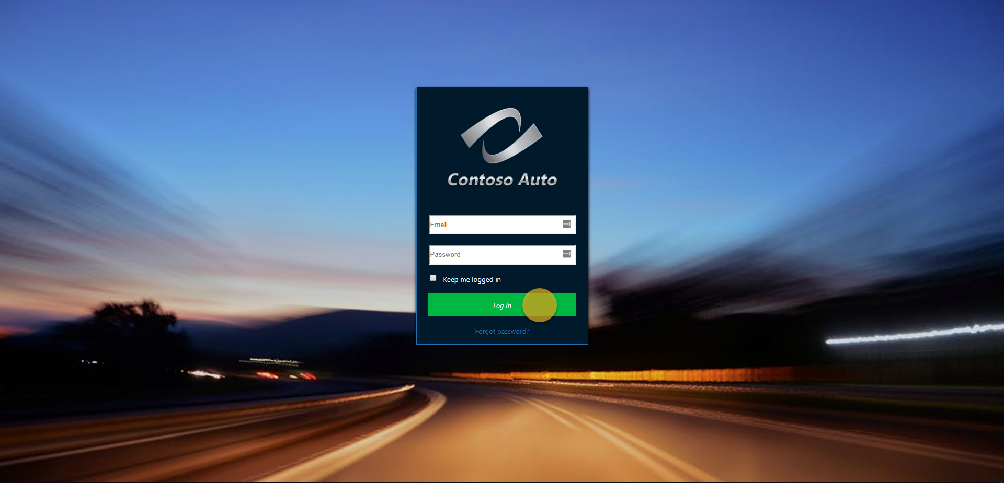

Slide 24
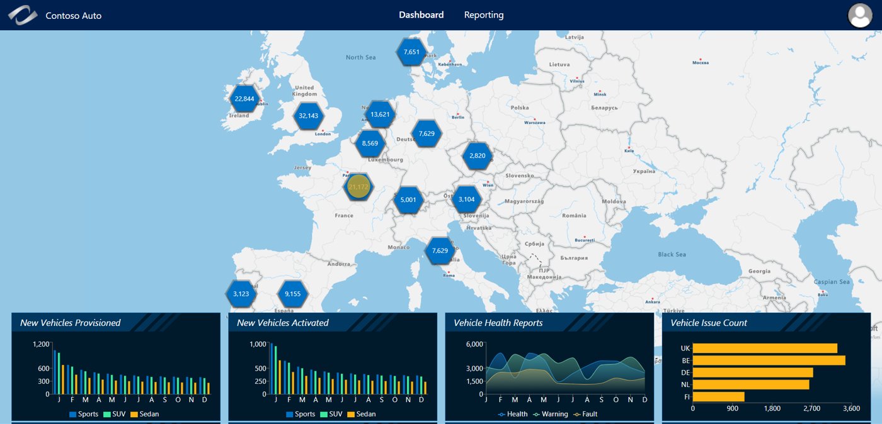

Slide 25
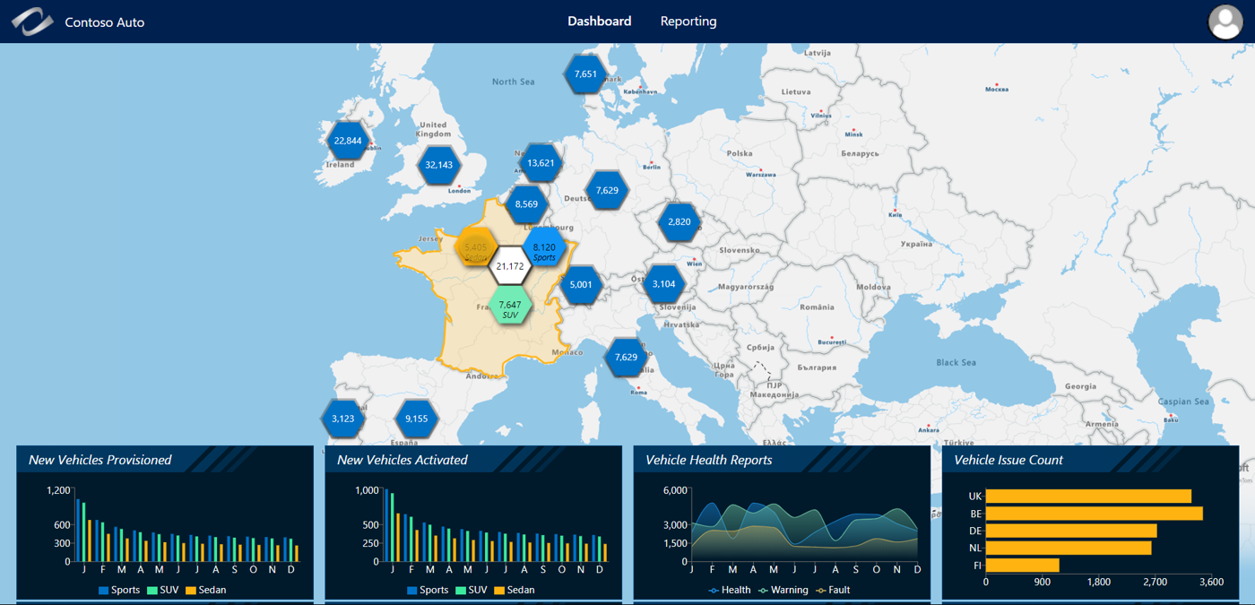

Slide 26
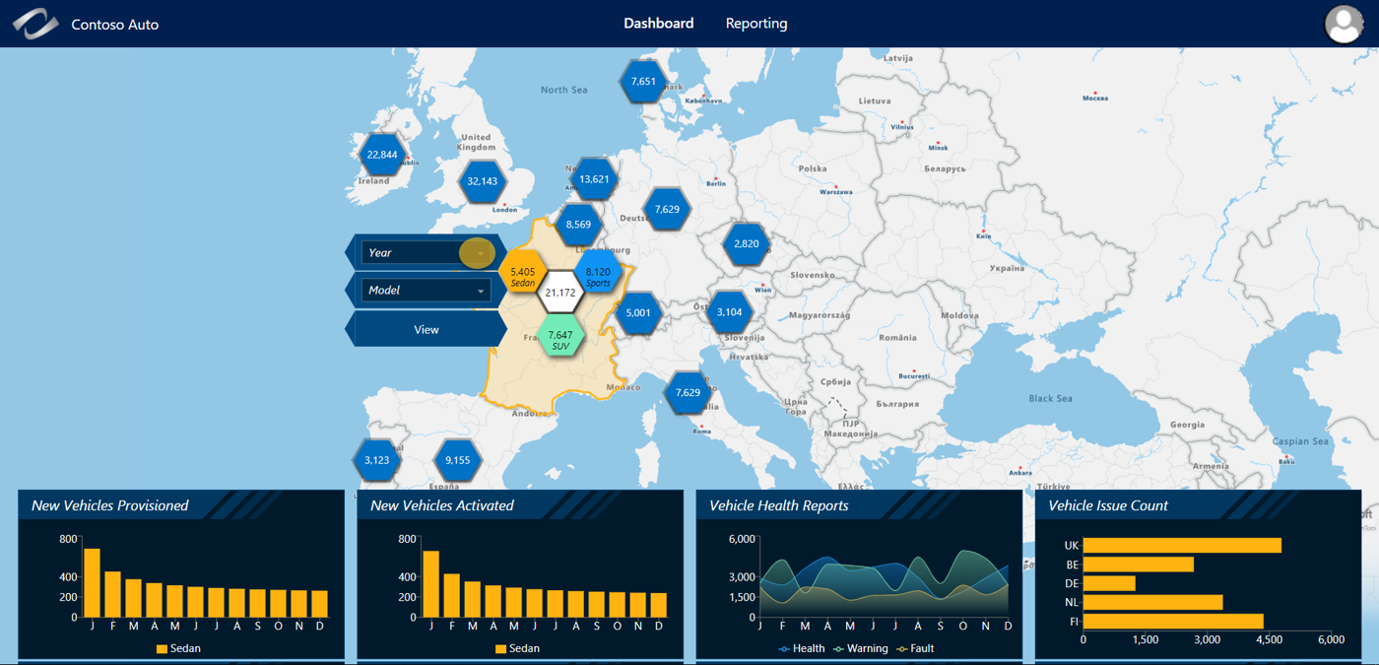

Slide 27
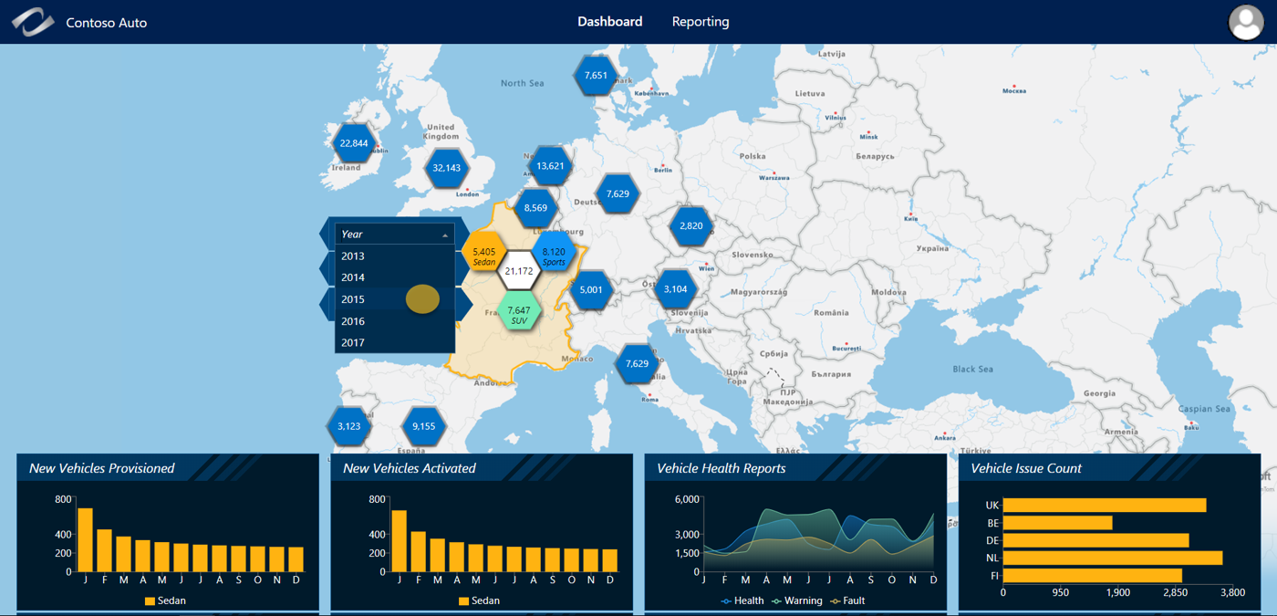

Slide 28
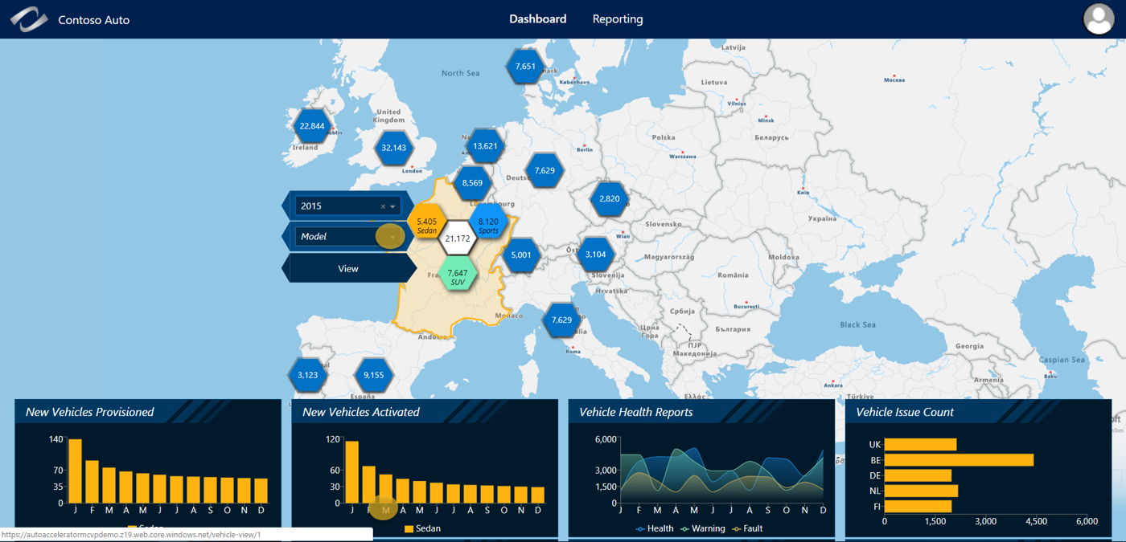

Slide 29
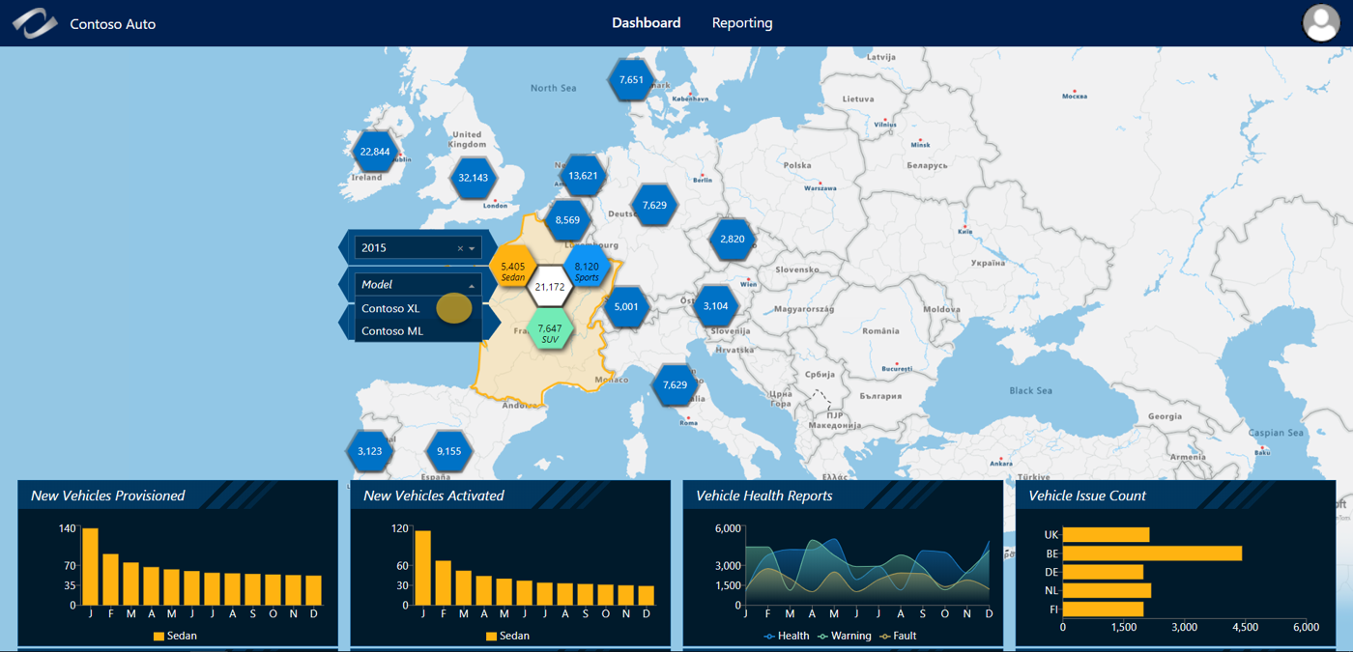


Slide 30
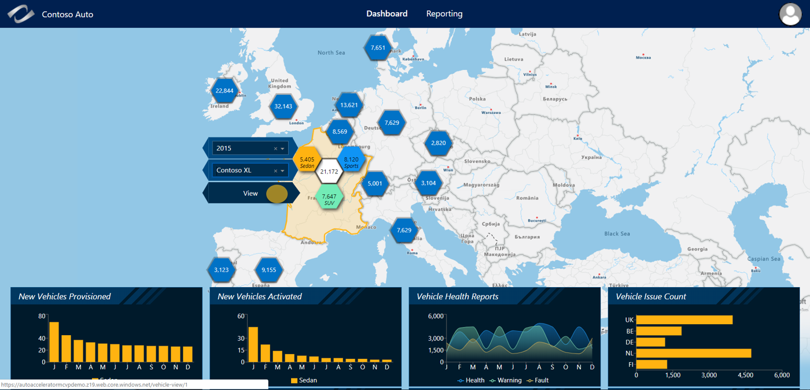

Slide 31
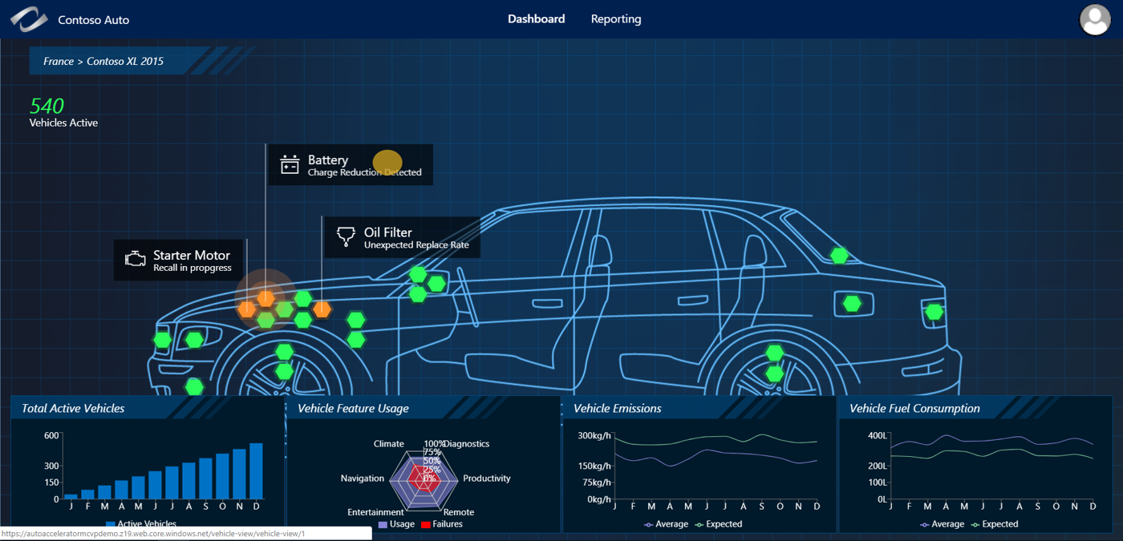

Slide 32
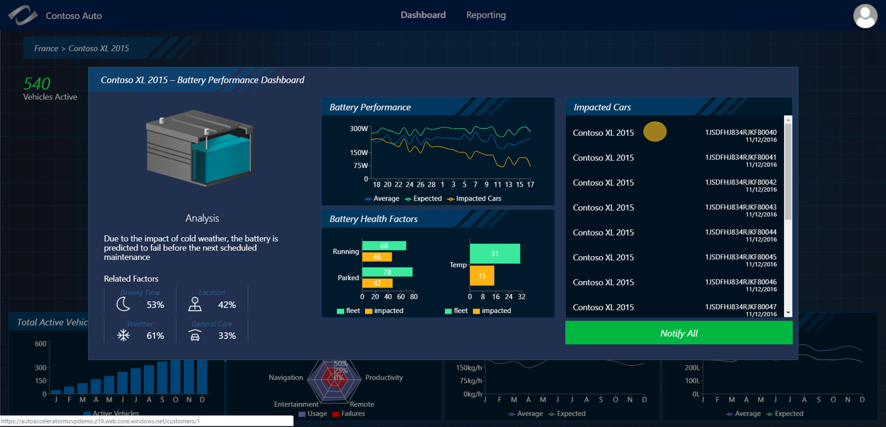

Slide 33
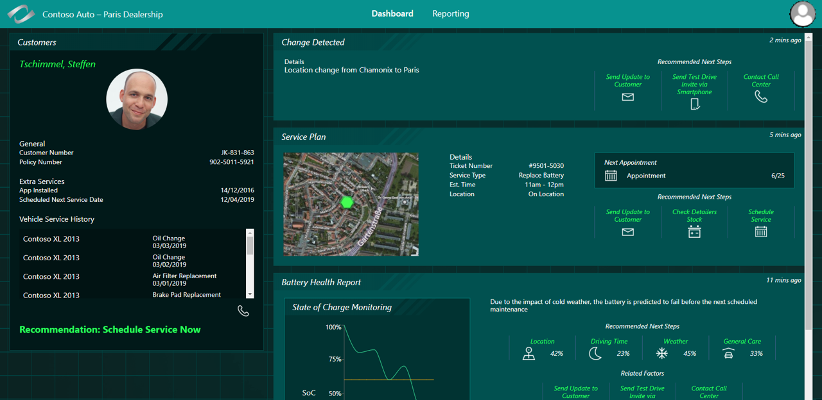

Slide 34
Service path summary
Contact center – proactive service identification
Contact Center – service scheduling
driver – finalizes service appointment
Dealer service advisor – oversees service delivery
Close & Cashiering
Survey
Promo
Reporting

Slide 35
Contact center associate
The contact center associate logs into the PowerApp to Schedule the maintenance appointment

Slide 36
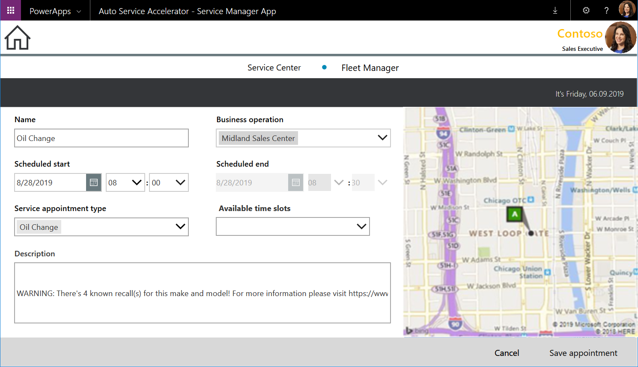

Slide 37
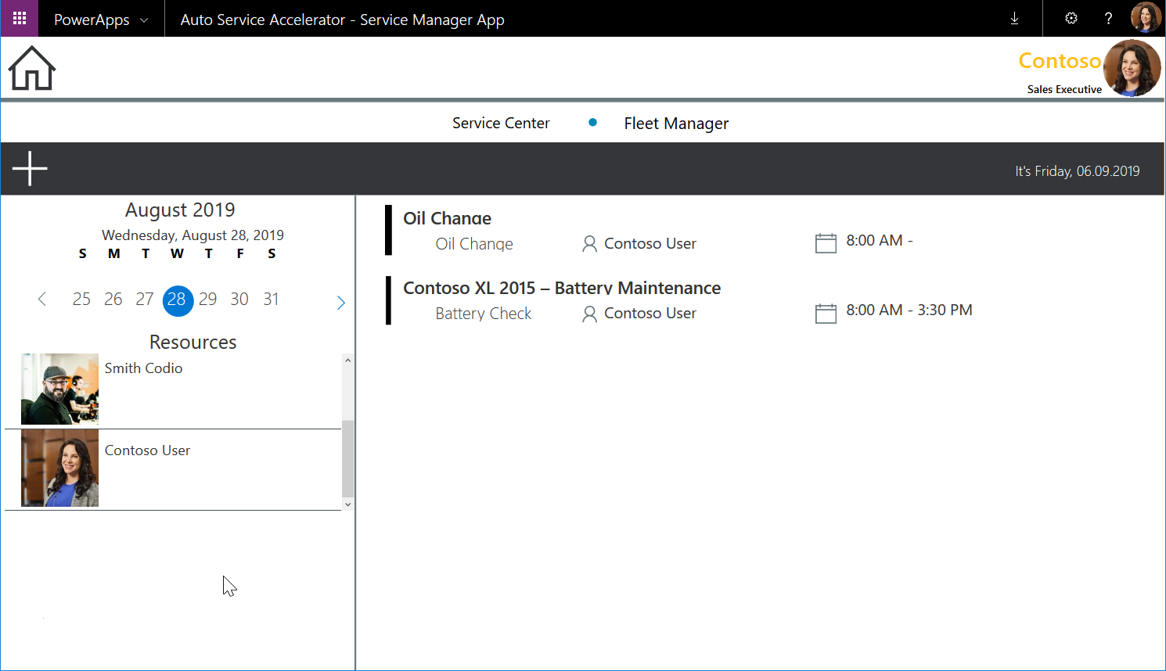

Slide 38
Service path summary
Contact center – proactive service identification
Contact Center – service scheduling
driver – finalizes service appointment
Dealer service advisor – oversees service delivery
Close & Cashiering
Survey
Promo
Reporting

Slide 39
Driver
The driver opens the app on their phone to review the service appointment and realizes that they will be late so they use the app to notify the Service Center

Slide 40
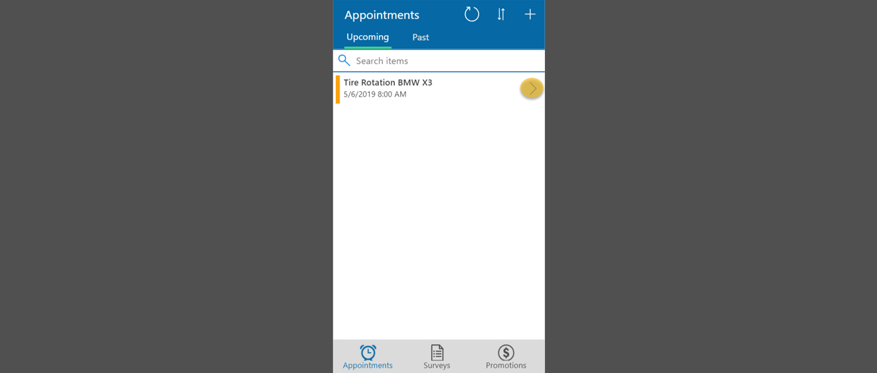

Slide 41
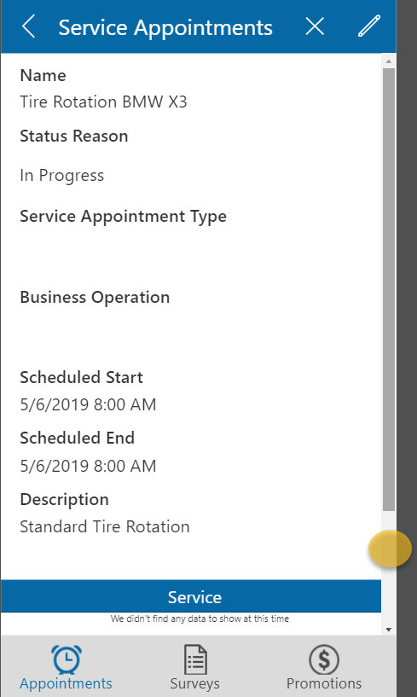

Slide 42
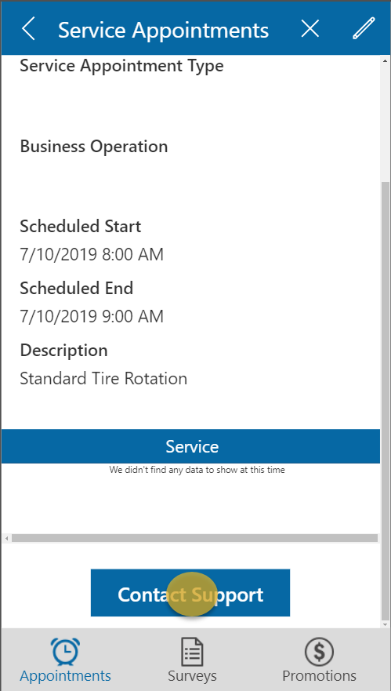

Slide 43
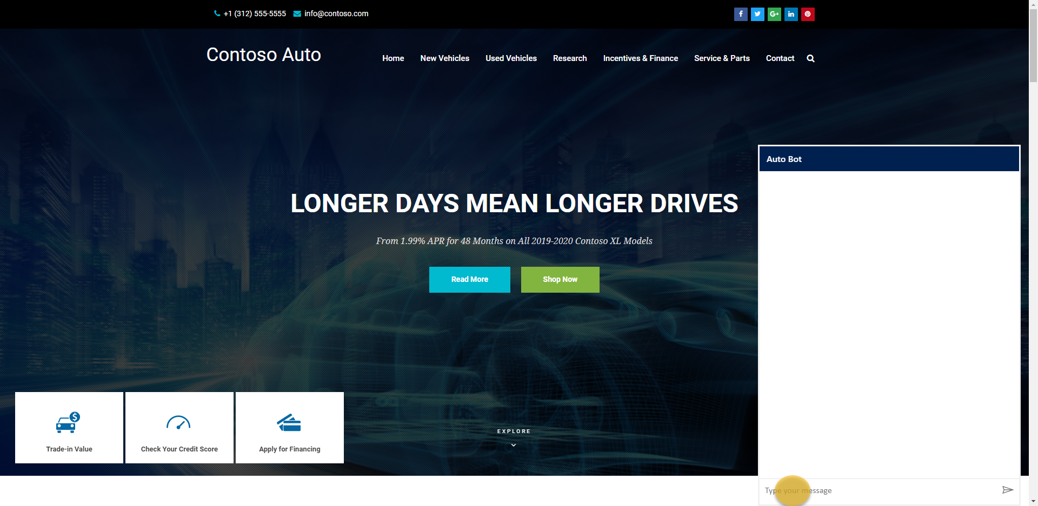

Slide 44
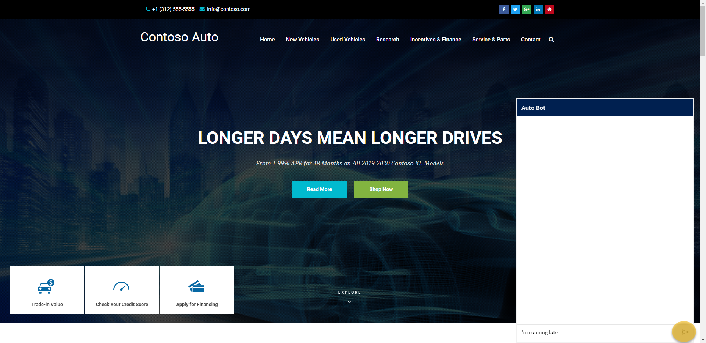

Slide 45
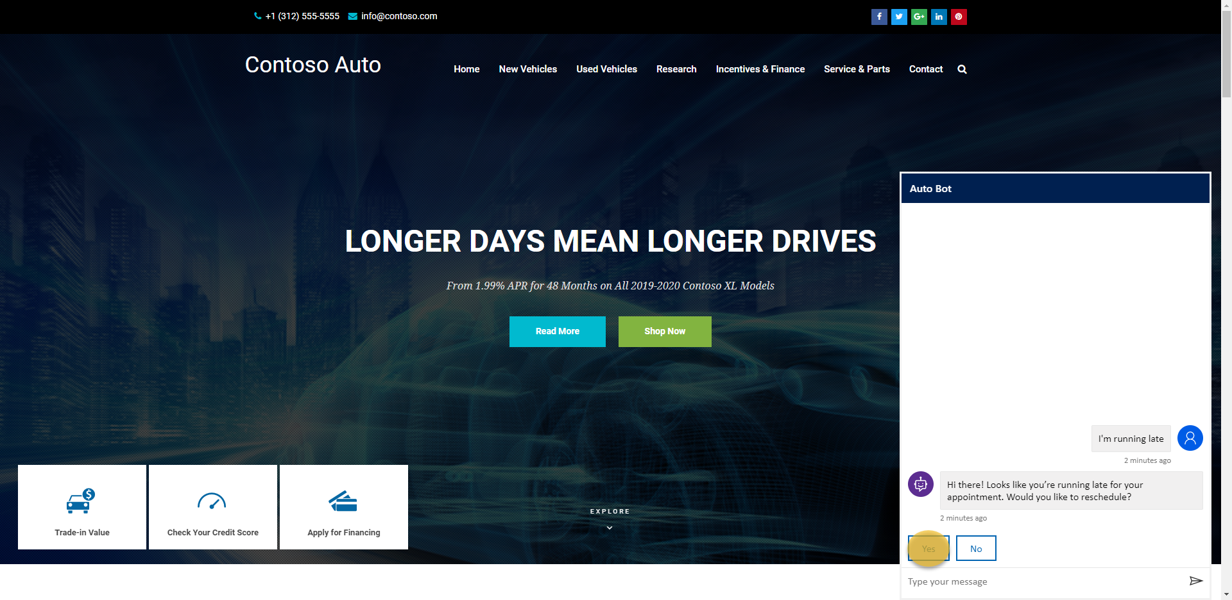

Slide 46
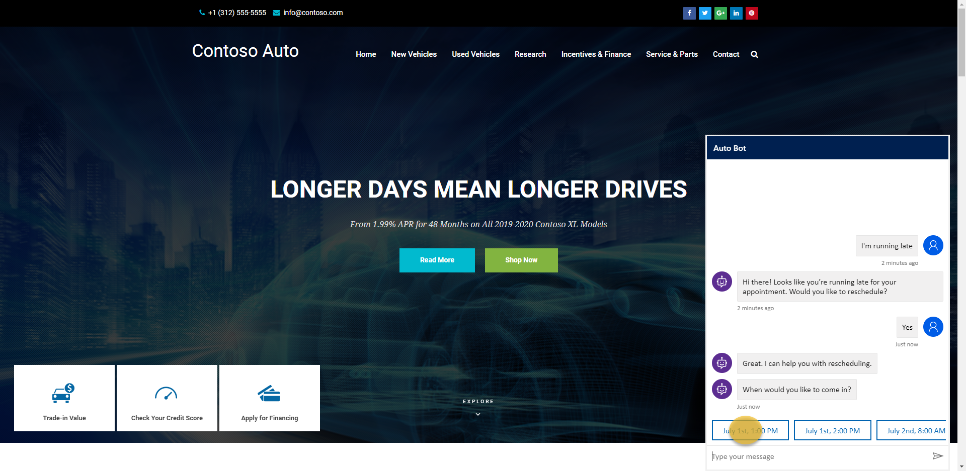

Slide 47


Slide 48
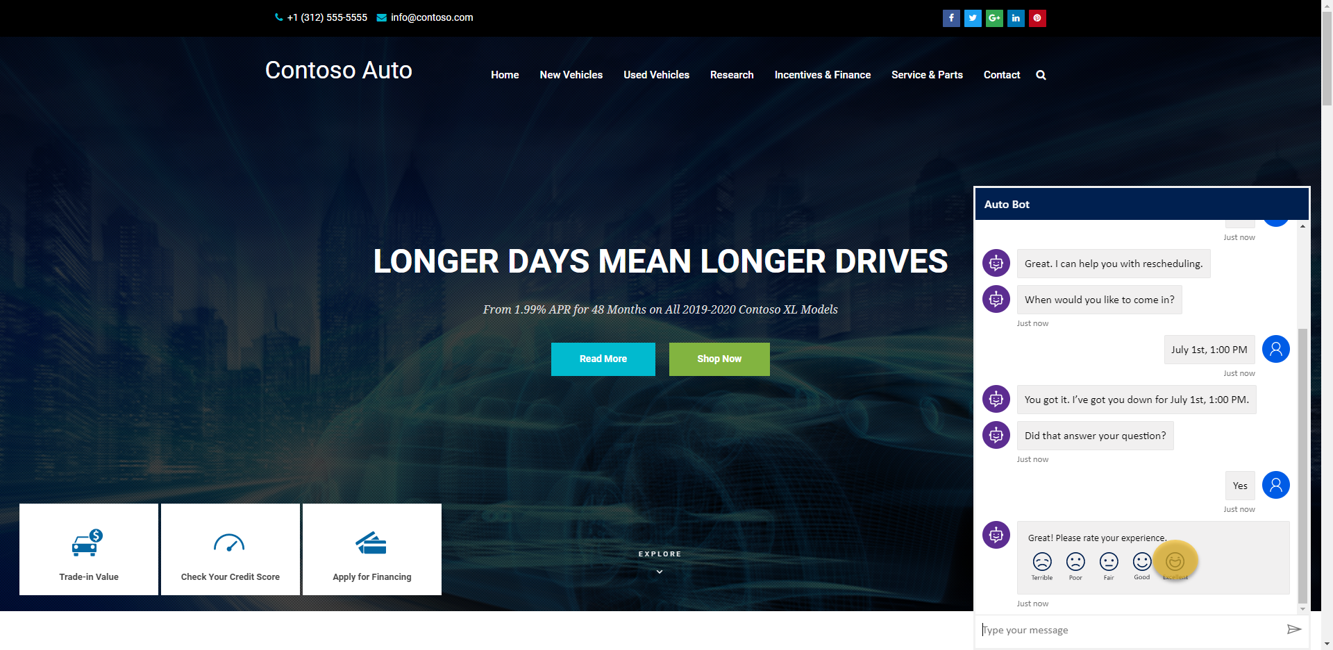

Slide 49
Service path summary
Contact center – proactive service identification
Contact Center – service scheduling
driver – finalizes service appointment
Dealer service advisor – oversees service delivery
Close & Cashiering
Survey
Promo
Reporting

Slide 50
Dealer service advisor
The Dealer Service Advisor at the Service Center logs into the App from their tablet to check the user in and transition to the Technician (potentially upselling in the process)

Slide 51
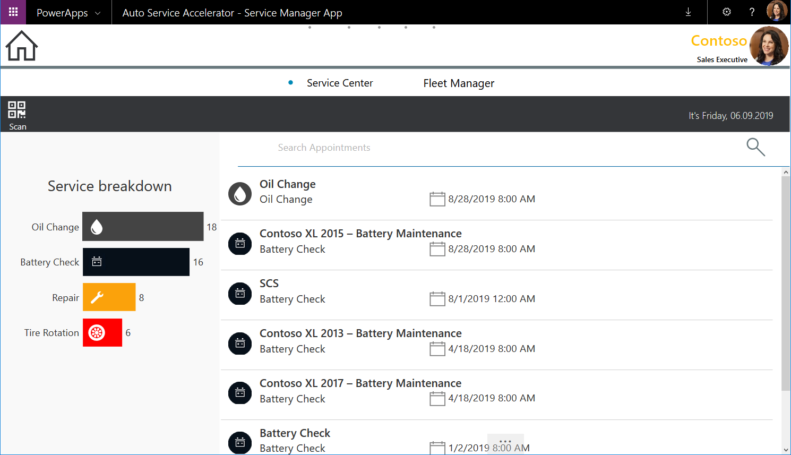

Slide 52
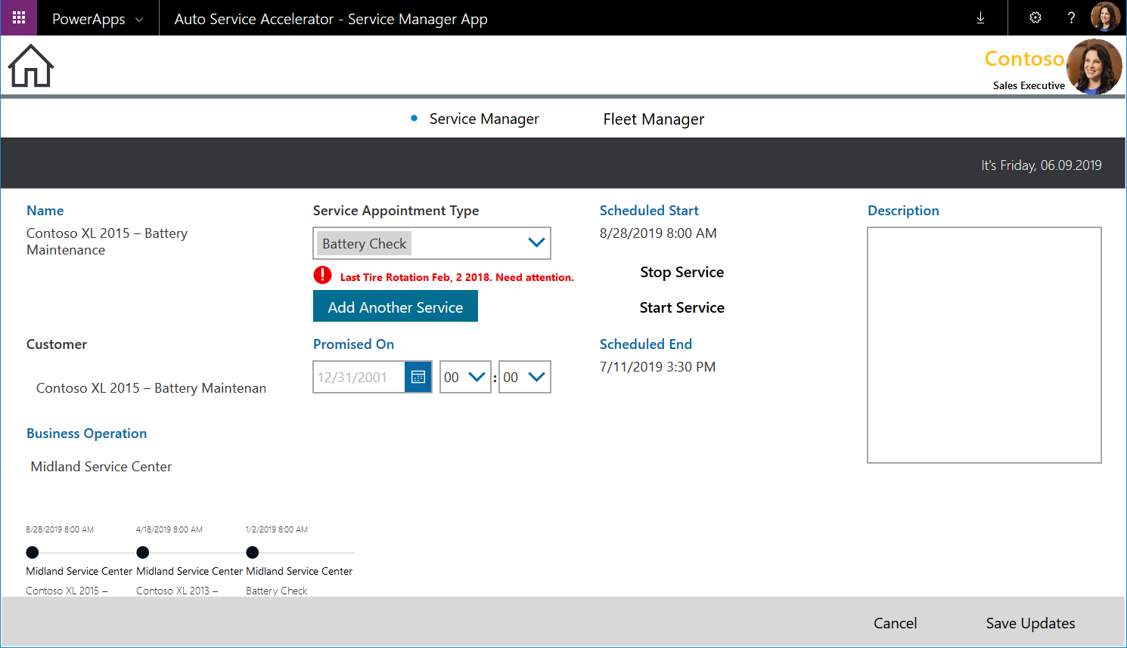

Slide 53
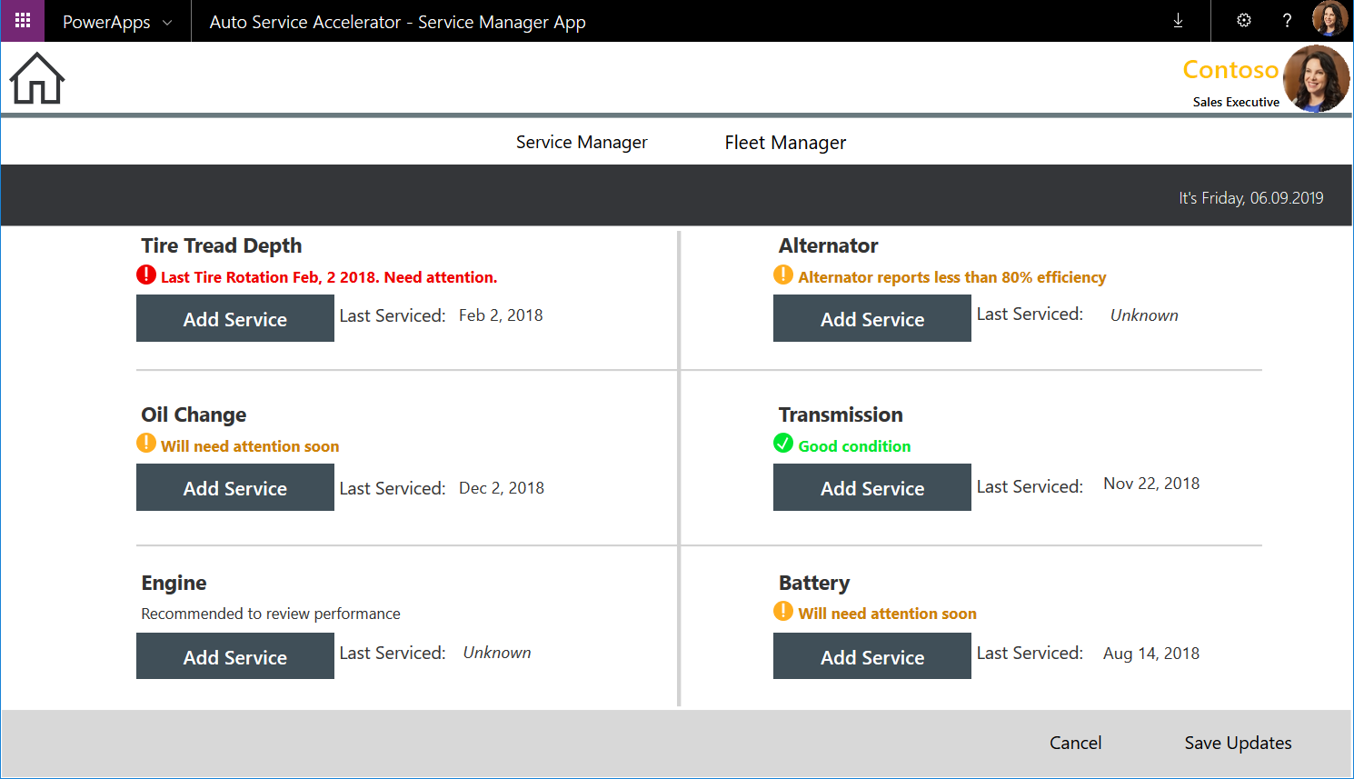

Slide 54
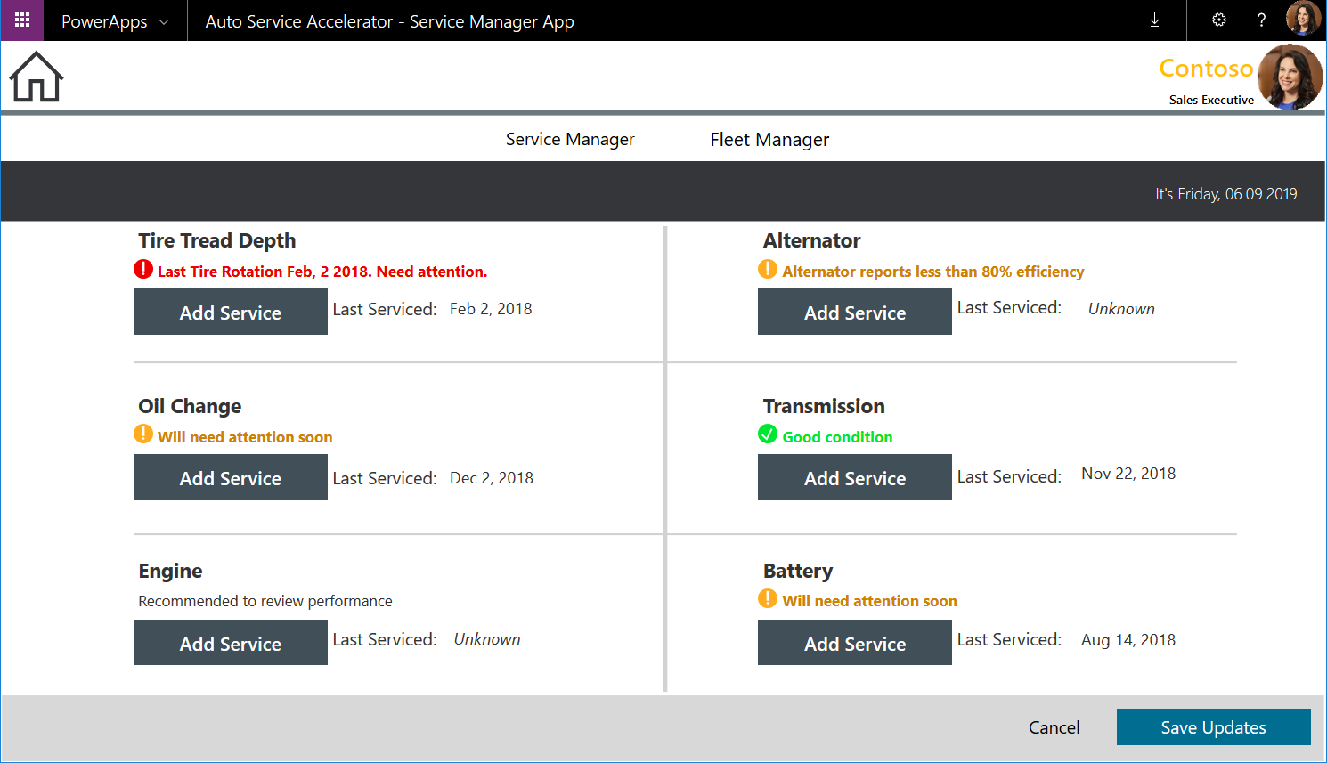

Slide 55
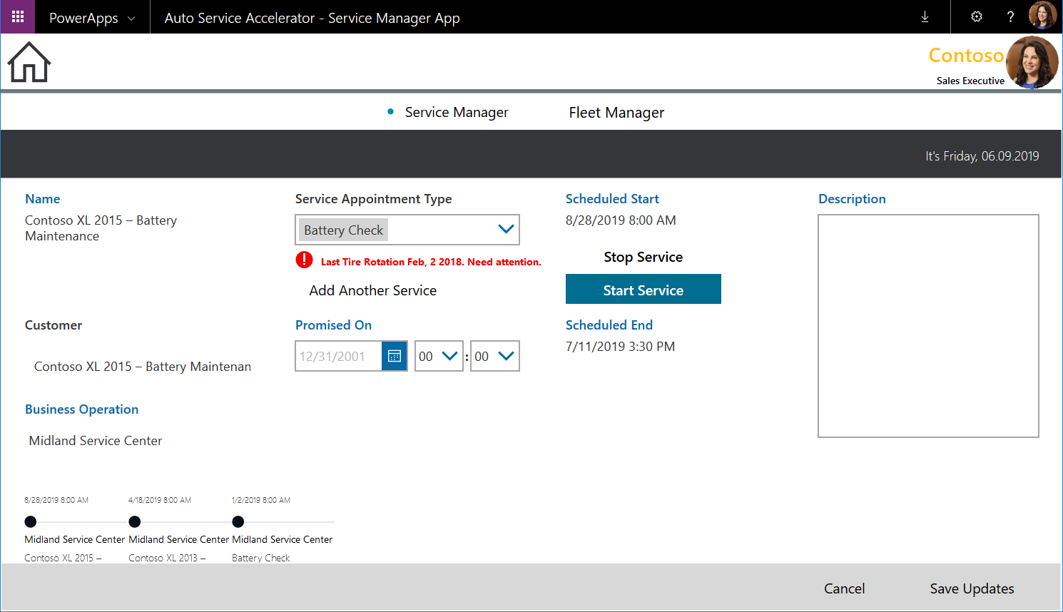

Slide 56
Service path summary
Contact center – proactive service identification
Contact Center – service scheduling
driver – finalizes service appointment
Dealer service advisor – oversees service delivery
Close & Cashiering
Survey
Promo
Reporting

Slide 57
Dealer service advisor
Once the technician is done servicing the vehicle, the representative reviews the work with the customer and has them sign off.

Slide 58
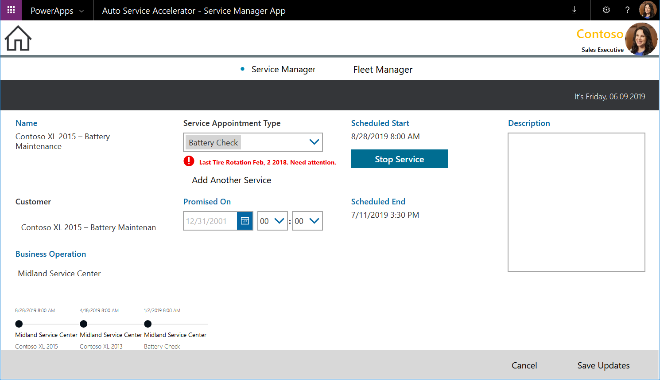

Slide 59
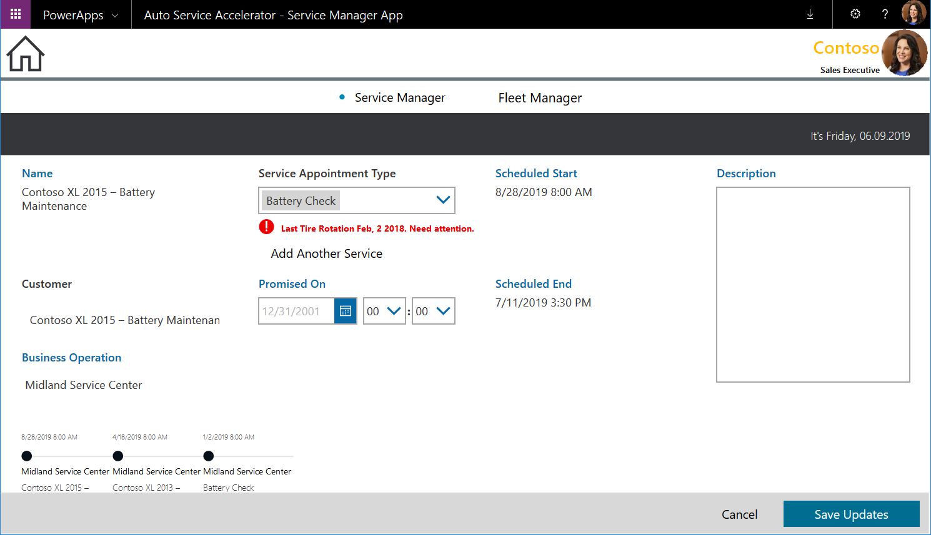

Slide 60
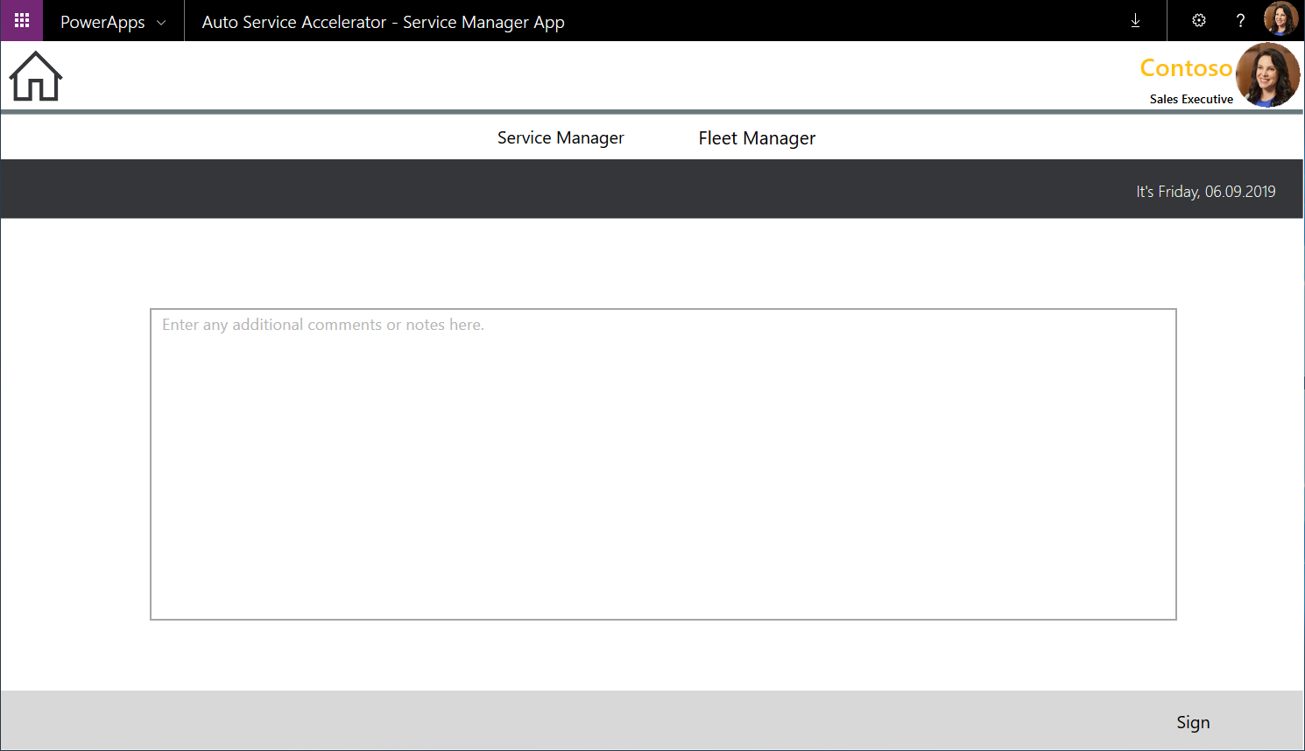

Slide 62
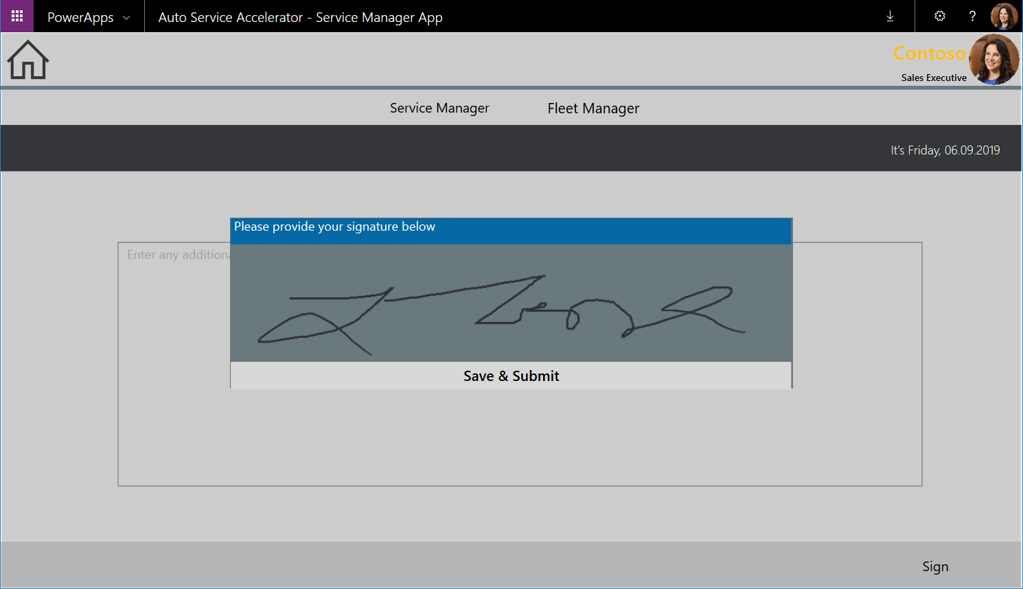

Slide 63
Service path summary
Contact center – proactive service identification
Contact Center – service scheduling
driver – finalizes service appointment
Dealer service advisor – oversees service delivery
Close & Cashiering
Survey
Promo
Reporting

Slide 64
Driver
The driver opens the app on their phone to fill out the survey about their visit to the Service Center

Slide 66
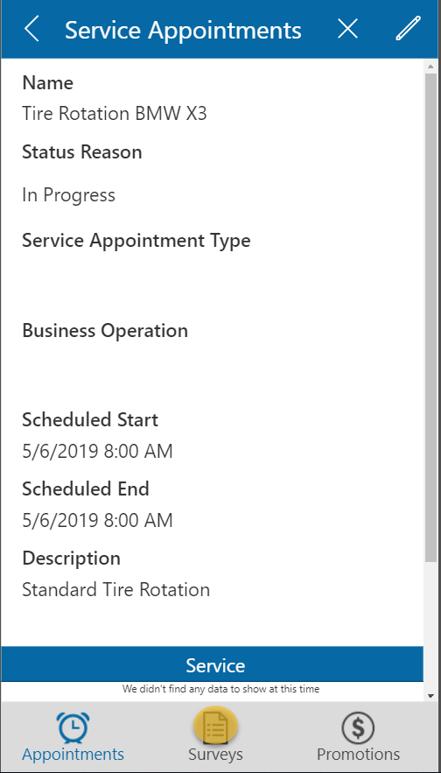

Slide 67
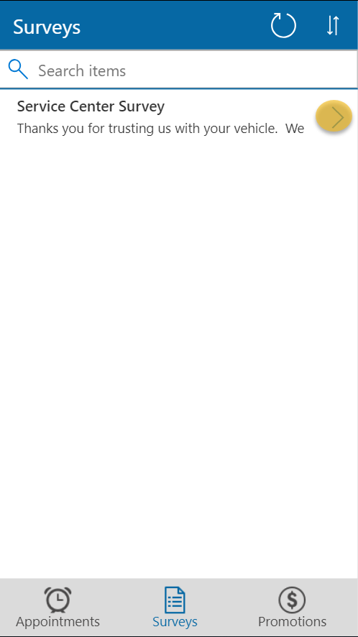

Slide 68


Slide 69


Slide 70
Service path summary
Contact center – proactive service identification
Contact Center – service scheduling
driver – finalizes service appointment
Dealer service advisor – oversees service delivery
Close & Cashiering
Survey
Promo
Reporting

Slide 71
Driver
The driver opens the app on their phone to review their free car wash as a promotion for providing feedback

Slide 72


Slide 73


Slide 74
Service path summary
Contact center – proactive service identification
Contact Center – service scheduling
driver – finalizes service appointment
Dealer service advisor – oversees service delivery
Close & Cashiering
Survey
Promo
Reporting

Slide 75
Service Center Manager
The Service Center Manager logs into Dynamics Customer Engagement to review the service center dashboard

Slide 76


